Slide 1
We build and support meaningful relationships between communities and UC Davis scholars who work together for the public good.
Notes:
Good morning and I would like to thank Phil and his team for giving us time with you.
I lead a dynamic team of individuals who are working tirelessly to elevate the public mission of UC Davis.
Public Scholarship and Engagement is…
A university-wide office established in July 2018, that serves both the Davis and Sacramento campuses, and all 10 colleges and schools
Our mission is to build and support mutually beneficial relationships between the university and diverse communities
We carry out our mission in a number of ways, some of which I will discuss here this morning.
Importantly, we value equity in scholarship and creating an institutional culture that welcomes and supports faculty that integrate community engagement into their research and teaching

Slide 2
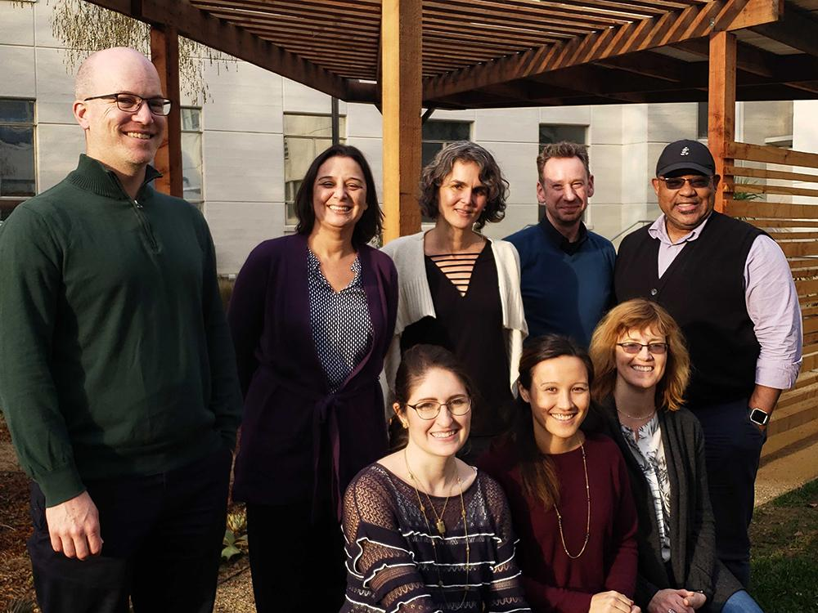
Faculty Fellows Programs
Community Engaged Learning Faculty Fellows
Public Scholarship Faculty Fellows
“It built a community around an idea that could foster scholarly development and advancement of its members. As practicing academics, it made our lives better; it helped improve our working conditions.”
Notes:
For the purpose of today’s presentation, I will focus on faculty supports but our office also manages a number of student and community facing programs and services.
From the office’s inception, a primary focus has been to support, reward, and recognize our faculty so that they can advance through the ranks.
Thus far, we have developed two cohort-based faculty fellows programs.
One of the fellowship programs recognizes and advances community-engaged learning experiences organized by faculty, bringing their students into experiential learning opportunities with community partners
Another fellows program focuses on advancing faculty scholarship. This second program also provides tools for communicating research with broad audiences, building relationships with community partners, and incorporating their work of high public impact into their merit and promotion documents.
Highlights of these programs include faculty who propose new experiential learning opportunities in their courses, submit manuscripts and research proposals that further their scholarship, and go on to receive university and national recognition for their work.
Over the past 2.5 years, there have been a total of 30 Fellows that have participated in these programs.

Slide 3
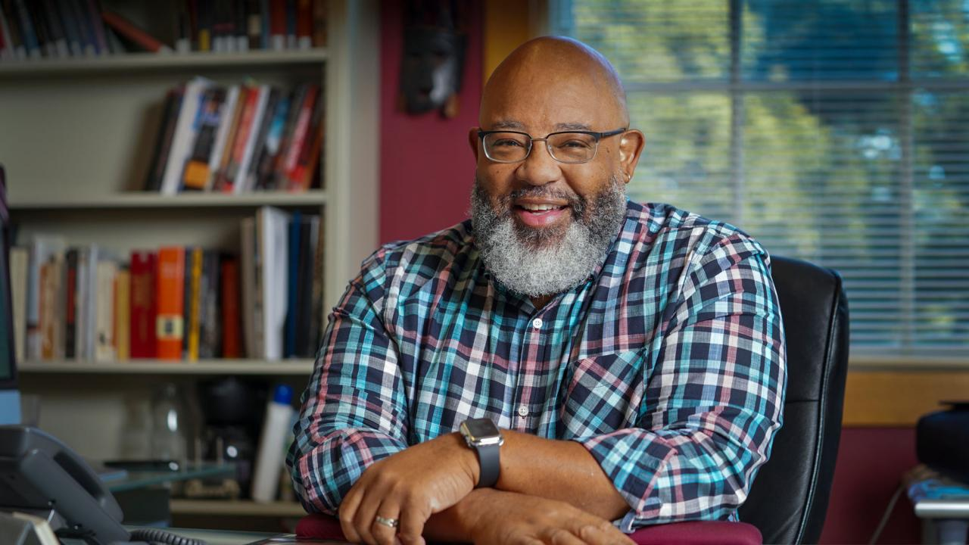
Milmon Harrison
Associate Dean
Undergraduate Education Faculty Fellow, 2020–21
“I sought a greater degree of integration between teaching, community engagement and my own research agenda. All of these interests were served through my class becoming part of a larger partnership in service to the people of California.”
Notes:
A short story here: Before Milmon Harrison was named Associate Dean for Undergraduate Education, he participated in both of our fellows programs at a time when he was significantly rethinking his approach to teaching and research.
Milmon has expressed that the Fellows programs played a key role in the development of a course focused on Black oral histories in collaboration with the Center for Sacramento History. But the programs also furthered his writing of a now-published journal article, and a subsequent positive merit review.
Both programs also supported his vision for experiential learning programs for undergraduates that integrate closely with university research.

Slide 4
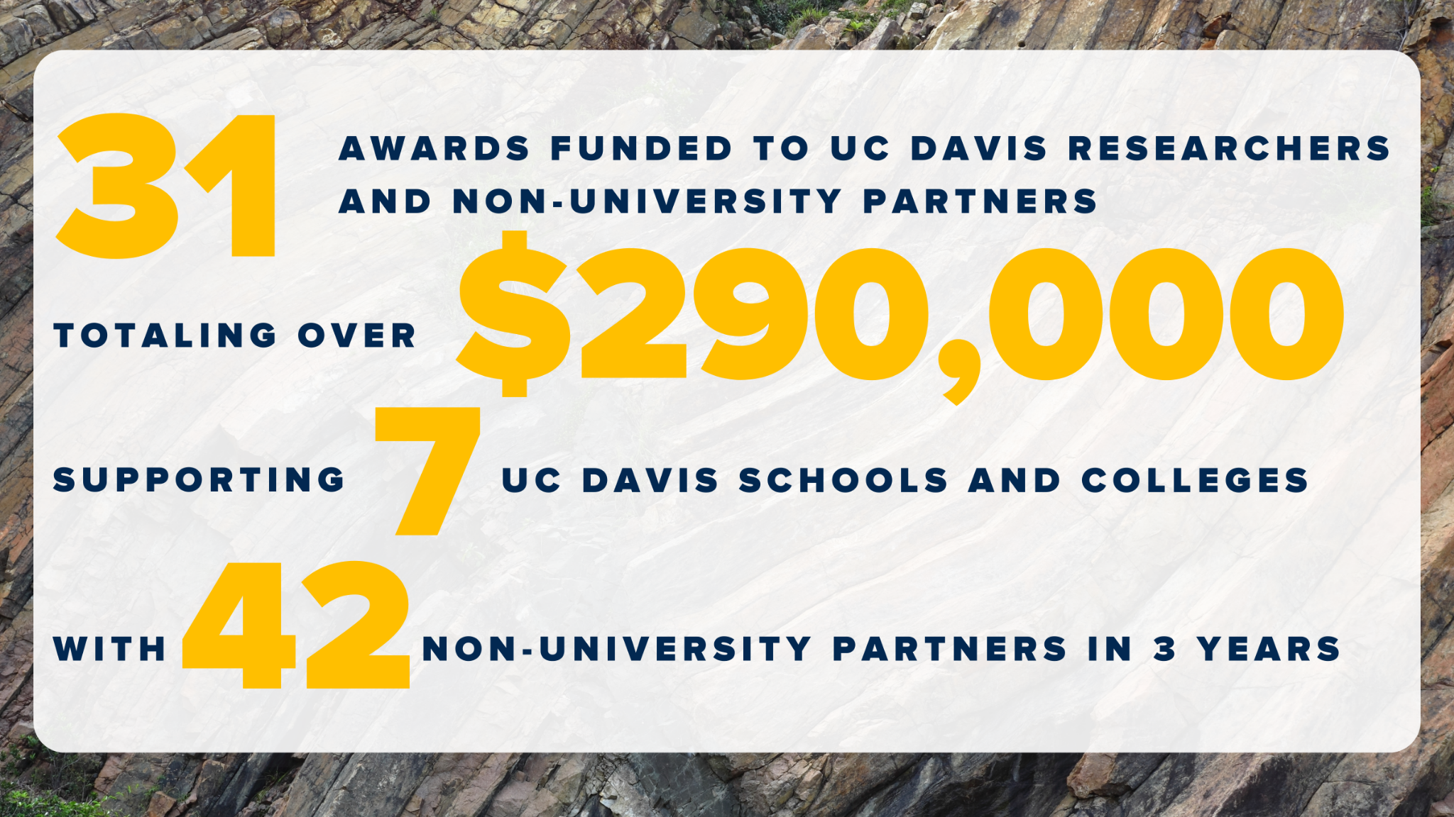
Public Impact Research Initiative
From 2020-2022, PIRI has supported:
Annual small grants program ($7-10K) to support research that involves a non-university partner
Approximately 8 to 10 grants awarded annually
Proposals are often the seed funding to get a larger initiative or program off the ground
“This PIRI project...allowed our collaboration with Resilient Yolo to mature and helped us start very meaningful and significant work in the community that we anticipate continuing to grow for years to come.”
Notes:
Another way that we support faculty, but also other university researchers, is through our research grants program - the Public Impact Research Initiative.
Through these grants, we fund projects done in partnership with a non-university group that have the potential for high public impact.
So far, we have been able to support a range of projects including, for example: looking at post-fire recovery in California, understanding Covid-19 impacts on immigrants, improving indigenous food sovereignty, and understanding breastfeeding rates of Black women in Sacramento. These projects support undergraduate and graduate students in research, alongside faculty and community partners.
A final note on our faculty facing programs - Individuals supported by our office have gone on to receive major national and international awards. Faculty have also received external funding after receiving seed funding and support from PSE.

Slide 5
Profiles in Engagement: Personal Experiences of UC Davis Faculty
“I remember the letter specifically attacked one very high-level journal in the Latino studies field as being minuscule and unimportant. That was really just kind of hard to hear, and I will say that it made me really give pause …. I wouldn't say that I would have abandoned my research, but it was definitely giving pause about well, is this an institution for me?”
“I get this vote back that, literally, is just disparaging of this entire work—that it's not in good enough journals. It was framed in a way that my (research) is too good for this type of work, and it made me really give pause because I then thought, what does that say to who I'm researching, what I'm researching? Are you saying I'm too good to be talking about these topics, I'm too good to be talking about these people, I'm too good to be writing in these journals?”
“…that's part of research too, but how do they account for that? That's not service. It's research, but always they're seeing it as service. For me, it's research because those are some of the needs the community has identified.”
Notes:
One of the other reasons for presenting to you this morning is to discuss public scholarship in merit and promotion.
I’ll pause here so that you can read some of these quotes from our faculty….(15 seconds)
It is important to note that recognition of public scholarship at UC Davis is the #1 concern expressed by faculty.
When it comes to merit and promotion, recognition is uneven at best and it is at the department and program-level where we hear the greatest inconsistencies exist.

Slide 6
Resources for Merit & Promotion:
Supporting Public Scholarship & Engagement
Faculty Resource Guide on PSE website — Specific guidelines and resources to help faculty and chairs describe and evaluate public scholarship.
Public scholarship often integrates the generation of knowledge, education, and service; therefore candidates can document these activities throughout their candidate statement in the research/teaching/service sections, as well as in the diversity statement.
Annual Call from Academic Affairs:
"While all areas of research and scholarship are valued, candidates often appreciate the opportunity to highlight unusual and distinguishing features of their work, such as influencing public policy, international research and engagement, public scholarship, work with underrepresented groups and disadvantaged communities, etc. Highlighting such efforts in the Candidate’s Statement can provide important insights that are otherwise not always evident in an advancement dossier."
Notes:
Because of this, our office has begun to
- Provide resources for guidance on merit and promotion. In addition to how to document public scholarship in faculty dossiers, our website also provides links to external resources as well as request a form for faculty workshops and consultations.
- We are also in exploratory discussions with Global Affairs and Grand Challenges to jointly offer workshops for departments and programs to improve documentation of broader impacts through public scholarship, global engagement, and interdisciplinary research.

Slide 7
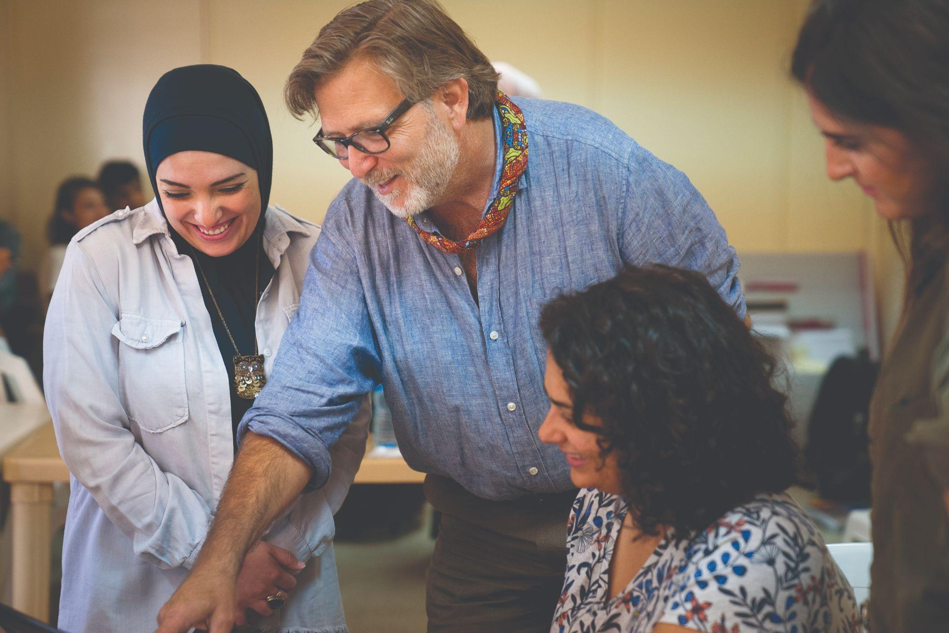
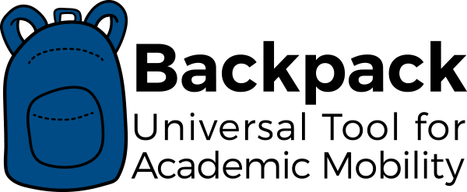
Why do we do this work?
“It's doing what we should be doing as scholars. Imagining our relationship to the world at large — how we can use what we study, work on, and explore, plus share the excitement and enthusiasm we have for our subjects, with others with the goal of contributing to a more peaceful and prosperous world.”
- Keith Watenpaugh, Professor and Director, Human Rights Studies PSE Faculty Fellow, 2021
Notes:
As an institution, we need your leadership to bring greater equity in scholarship to advance faculty from step to step and through the ranks.
Practically speaking, this is also a matter of faculty recruitment and retention, especially for women and faculty of color that are disproportionately represented in public scholarship.
I will close by asking you to share all of these resources with not only your junior faculty or individuals going up for a merit or promotion action, but with others involved in your personnel review process.
Thank you for your time. I welcome any question you have.

